Slide 1
Introduction to Computer Science (371-1-1601)
Lectures by: Dr. Dan Vilenchik & Dr. Zion Siksik
Recitations by: Ariel Cohen, Moshiko Davidian, Assaf Livne, Yair Mazal

Slide 2
Recitation 10 Binary Trees

Slide 3
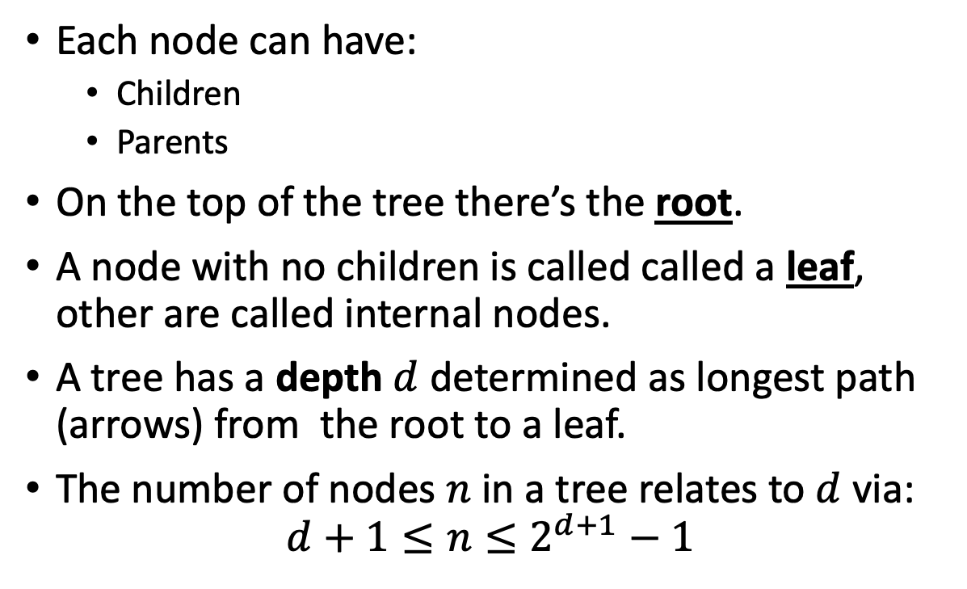
Tree Terminology
Each node can have:
Children
Parents
On the top of the tree there’s the root.
A node with no children is called called a leaf, other are called internal nodes.
A tree has a depth $d$ determined as longest path (arrows) from the root to a leaf.
The number of nodes $n$ in a tree relates to $d$ via:
$$d+1≤n≤2^{d+1}−1$$
1
2
3
5
6
7
8

Slide 4
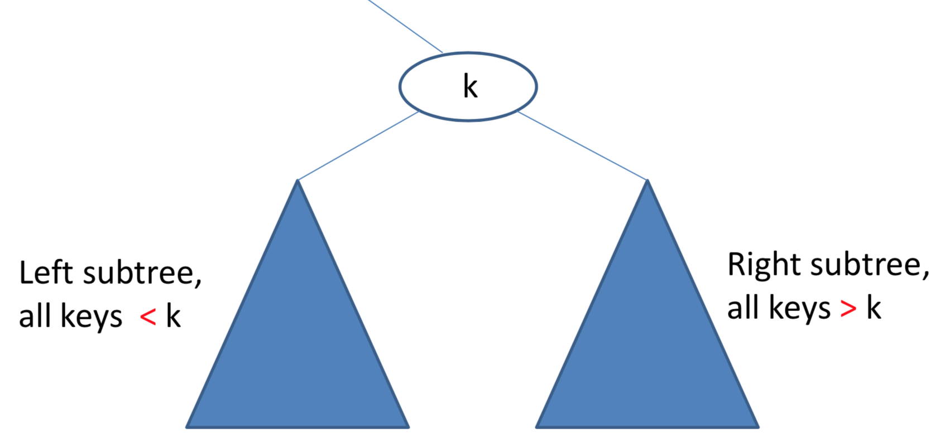
Binary Search Trees
Binary search trees have the additional property that they are ordered.
They have many uses

Slide 5
Exercise – Tree Lookup
Download the file “g_binary_tree_basic.py” from moodle.
Implement a method “find_val” for the class. The method accepts a single argument – a lookup value.
The method returns true if the value is found and false otherwise.
Remember the tree is binary search tree. Can this help you?

Slide 6
Lookup
def findval(self, lkpval) -> bool: if lkpval < self.data: if self.left is None: return False return self.left.findval(lkpval) elif lkpval > self.data: if self.right is None: return False return self.right.findval(lkpval) else: return True
12
12
6
14
3
8

Slide 7
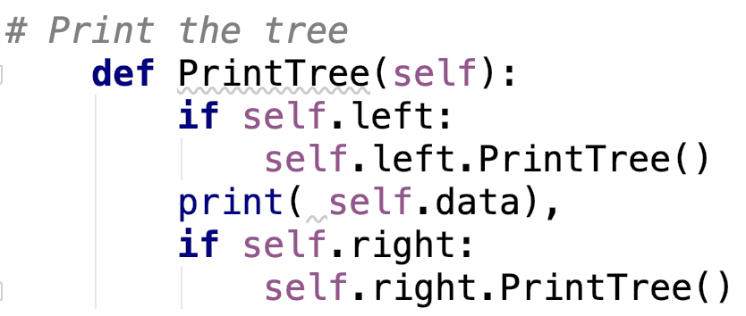
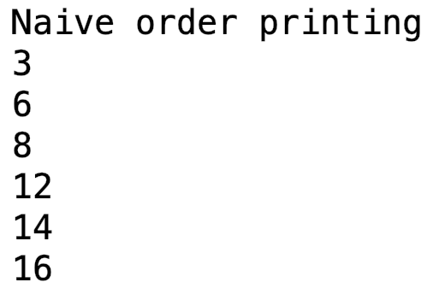
Traversing trees
12
12
Let us print a tree:
6
14
3
8
16
Can we print by depth?

Slide 8
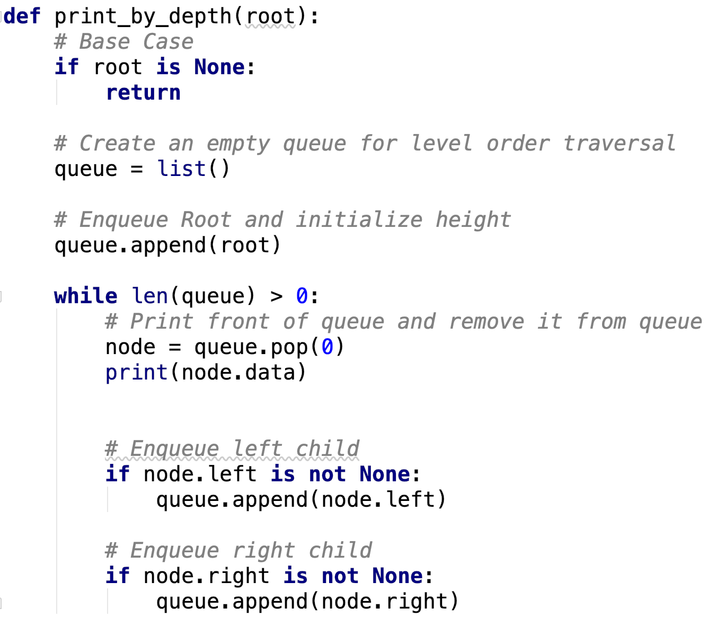
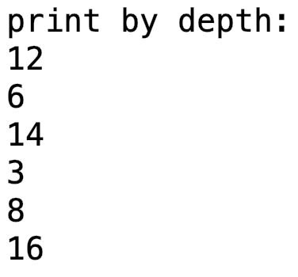
Print by depth – taken from here
12
12
6
14
3
8
16
We use a queue to alter the order
Breadth First Traversal
How would you print right before left?

Slide 9
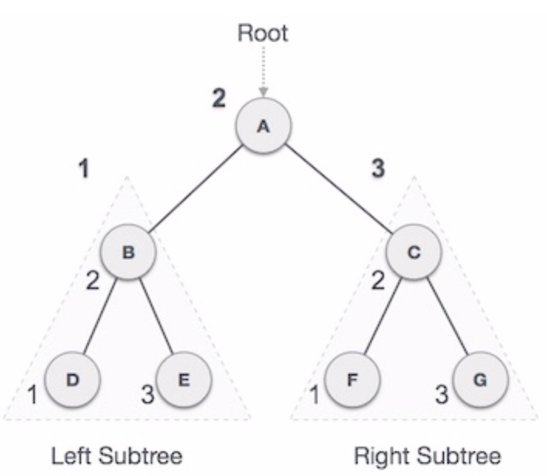
Standard traversal orders – In-Order
In-order Traversal - left subtree, root, right subtree
Good for generating sorted values in ascending order
Example of
Depth First Traversal
Uses a stack
Example without recursion:
here

Slide 10
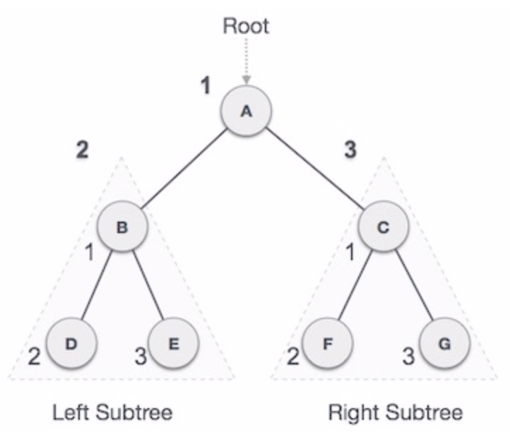
Standard traversal orders – Pre-Order
Pre-order Traversal - root , left subtree, right subtree
Good for copying trees
General description of traversal order:
General
In Python
Example without recursion:
here

Slide 11
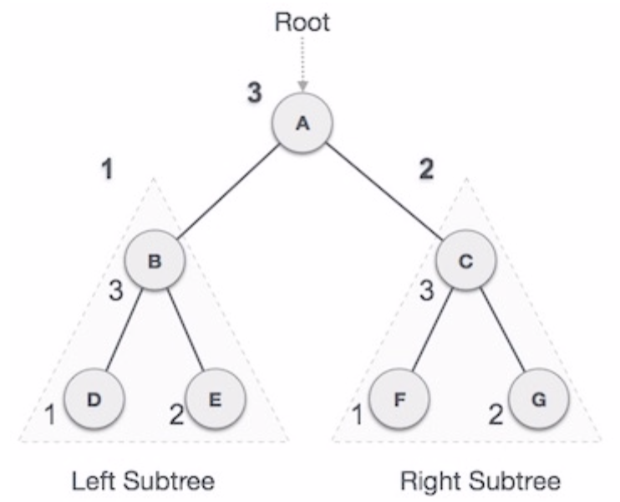
Standard traversal orders – Post-Order
Post-order Traversal - left subtree, right subtree, root
Good for deleting trees (where you’re responsible for it)
A bit more complex without recursion, can be done easily with two stacks
Example without recursion:
here

Slide 12
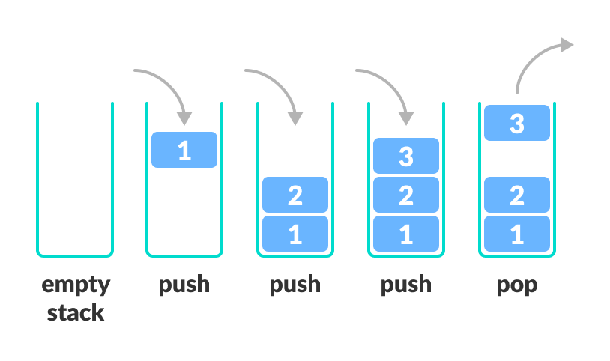
Exercise – Print values sorted
As explained above, getting odered elements can be done using ‘in order traversal’.
This can be implemented using a stack.
In python a stack can be simply implemented using a list with:
pop()
append()

Slide 13
Exercise – Print values sorted
Download the file “g_binary_tree_basic.py” from moodle.
Implement a method “in_order_traversal” for the class.
The method returns the elements of the tree in an ascending order.

Slide 14
Exercise – Print values sorted - solution
def in_order_traversal(self): # Set current to root of binary tree current = self stack = [] # initialize stack result = list() while True: # Reach the left most Node of the current Node if current is not None: # Place pointer to a tree node on the stack # before traversing the node's left subtree stack.append(current) current = current.left # BackTrack from the empty subtree and visit the Node # at the top of the stack; however, if the stack is # empty you are done else: if len(stack) > 0: current = stack.pop() result.append(current.data) # We have visited the node and its left # subtree. Now, it's right subtree's turn current = current.right else: break return result
We go left down the tree to push smalles items to the stack.
When we hit bottom, we start backtracking.
Whenever popping, if possible go right.

